Slide 1
RH SA1
Red hat System Administration 1
By: AYA ASHRAF
HPC SYSTEMS ENHINEER

Slide 2
Course Overview
Chapter 1: Operating System Fundamentals & Linux Introduction
Chapter 2: Command Line Access & Shell Basics
Chapter 3: File Management from Command Line
Chapter 4: Linux Help System & Documentation
Chapter 5: Text File Creation & Editing

Slide 3

Linux Components
1
🔧 Kernel
Core of the operating system
Manages hardware resources
Controls system processes
Handles memory management
Provides security
User cannot directly interact
2
🖥️ Shell
Interface between user and kernel
Command interpreter
Accepts user commands
Translates commands for kernel
Examples: bash, zsh, csh
User's primary interaction point

Slide 4
command [options] [arguments]
• options change a behavior of command (optional)
• Argumentsare files name or other information needed by the command. (optional)
• Each item is separated by a space.
• Separate commands with semicolon (;).
• For documentation or help:
• man command
• command --help

Slide 5
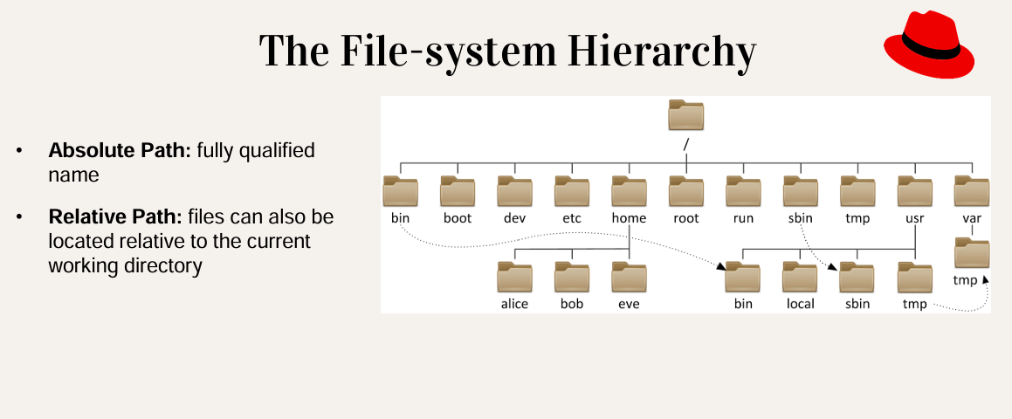

Slide 6
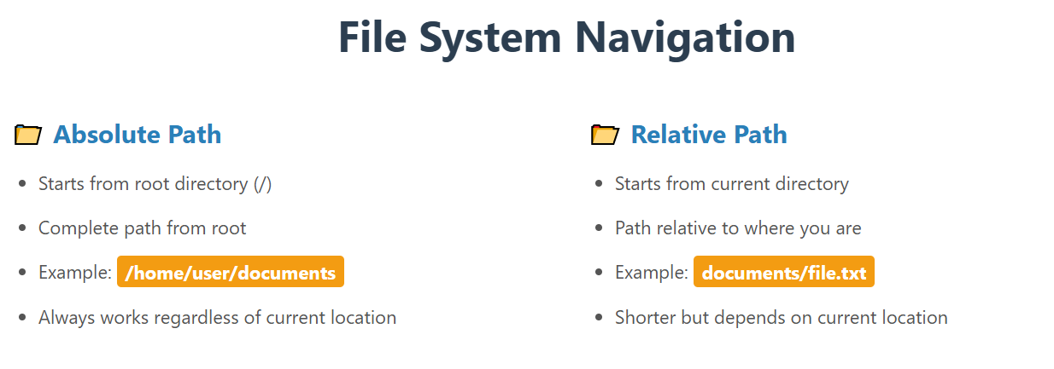

Slide 7
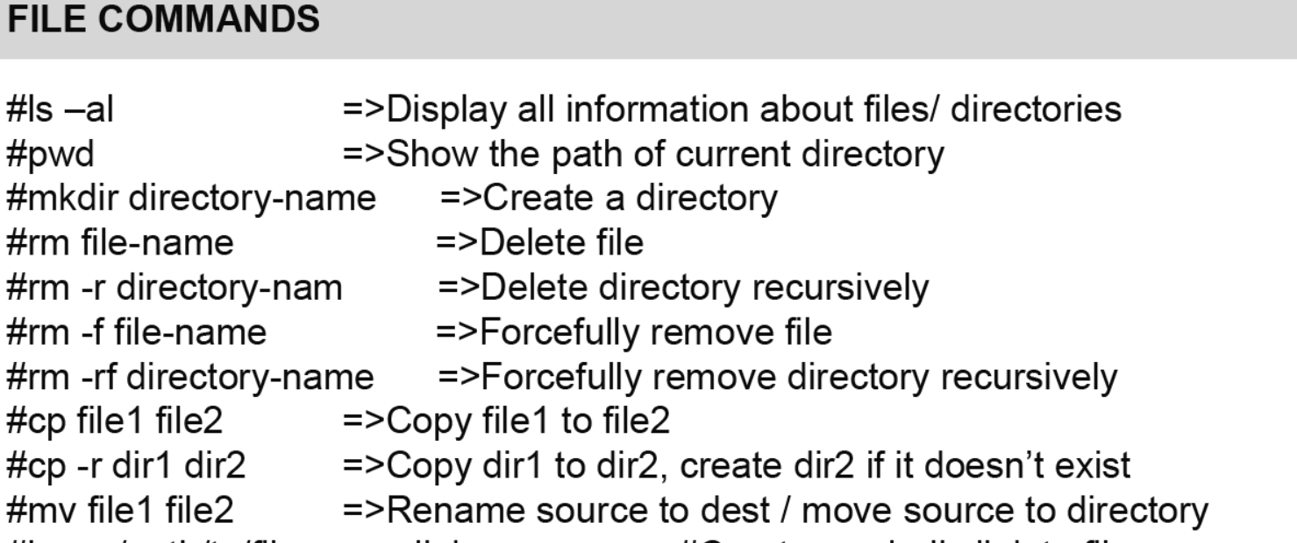

Slide 8
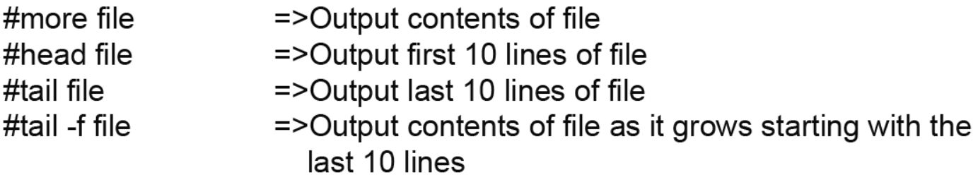

Slide 9
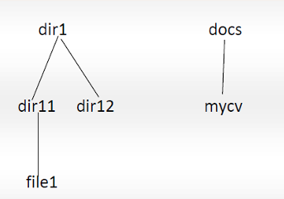
LAB 1
1. Install CentOS /RHEL
2. What is the difference between cat, more and command?
3. What is the difference between rm and rmdir using man?
4. Create the following hierarchy under your home directory:
a) Remove dir11 in one-step. What did you notice? And how
did you overcome that?
b) Then remove dir12 using rmdir–p command. State what
happened to the hierarchy (Note: you are in your home
directory).
c) The output of the command pwdwas /home/user. Write
the absolute and relative path for the file mycv

Slide 10
LAB 1
5. Copy the /etc/passwd file to your home directory making its name is mypasswd.
6. Rename this new file to be oldpasswd.
7. You are in /usr/bin, list four ways to go to your home directory
8. List Linux commands in /usr/bin that start with letter w
9. Display the first 4 lines of /etc/passwd
10. Display the last 7 lines of /etc/passwd
11 . Display the man page of the passwd file.

